Slide 1
Climate Change and Energy Transition
University of Coimbra Institute for Legal Research
Territorial Governance: Climate Change, Rehabilitation and Housing
3 November 2023
Natália de Almeida Moreno
(nataliamoreno@fd.uc.pt)

Slide 2
Antropogenic Climate Change
Multiple different C&E -» multilevel complex problem -» global commons, “super wicked” problem
Immediate, rapid and large-scale responses -» tipping points and poinf of no return
Shared responsibility -» Common but Differentiated Responsibilities and Respective Capabilities (CBDR–RC)
“Climate change is a global commons problem that implies the need for international cooperation in tandem with local, national, and regional policies on many distinct matters. Because the GHG emissions of any agent (individual, company, country) affect every other agent, an effective outcome will not be achieved if individual agents advance their interests independently of others” (IPCC, Climate Change 2014: Mitigation of Climate Change. Contribution of Working Group III to the 5th Assessment Report)
“When multiple actors—national, regional, and urban policymakers, as well as nonstate actors and civil society—work together to exploit the opportunities, it leads to the most impactful mitigation gains”; therefore, “[m]ultilevel and polycentric governance is essential for implementing sufficiency, energy efficiency and renewable energies policies” (IPCC, Climate Change 2022: Mitigation of Climate Change. Contribution of Working Group III to the 6th Assessment Report)

Slide 3
2015 Paris Agreement -» EU 1st NDC (40% by 2030) -» EU 2nd and enhanced NDC (55% by 2030) -» 2020 Green Deal
Regu﻿lation (EU) 2018/199 - Governance of the Energy Union and Climate Action + Regulation (EU) 2021/1119 - The European Climate Law -» Fit for 55 (2021 onwards) + REPowerEU
New EED (Directive (EU) 2023/1791)-» in force -» “goal of consuming at least 11.7% less energy by 2030 compared to the projected energy use for 2030 (based on the 2020 reference scenario)” (https://energy.ec.europa.eu/topics/energy-efficiency/energy-efficiency-targets-directive-and-rules/energy-efficiency-targets_en)
Recital 15 : “[E]nergy efficiency is to be treated as an energy source in its own right. The energy efficiency first principle is an overarching principle that should be taken into account across all sectors, going beyond the energy system, at all levels, including in the financial sector” -» Article 3
New RED (pending publication) -» “raise the share of renewable energy in the EU’s overall energy consumption to 42.5% by 2030 with an additional 2.5% indicative top up to allow the target of 45% to be achieved” (https://www.consilium.europa.eu/en/press/press-releases/2023/10/09/renewable-energy-council-adopts-new-rules/)

Slide 4
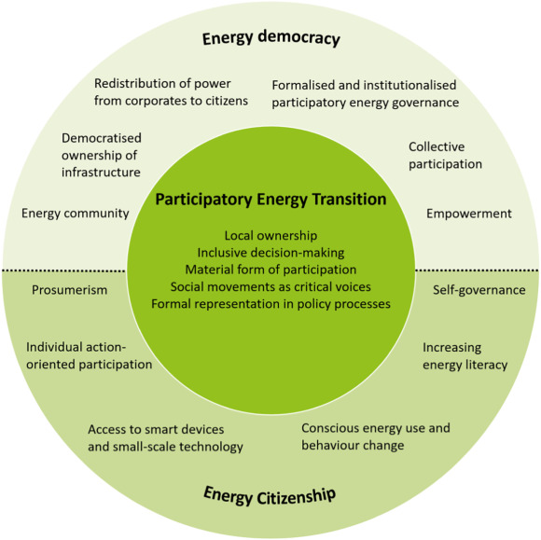
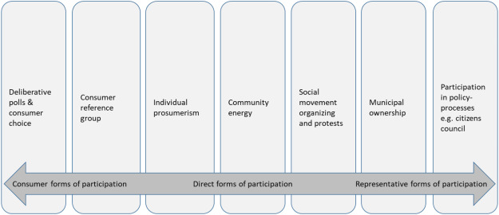
Just and equitable energy transition
Democractic, participatory
Wahlund, M., & Palm, J. (2022). The role of energy democracy and energy citizenship for participatory energy transitions: A comprehensive review. Energy Research & Social Science, 87

Slide 5
Democratisation
(i) Citizens’ Panels, Assemblies, Councils -» ad hoc, permanent, both
E.g., Citizens’ Panel on Edmonton’s Energy and Climate Challenges; Wallonië Citizen Panel for the Climate; Conselho de Cidadãos de Lisboa; Conseil Citoyen Permanent de Saint-Gilles; Ostbelgien Model
(ii) Remunicipalisation
More than 1.500 cases worldwide since 2000 (Cumbers, Andrew, et al., Mapping Remunicipalisation: emergente trends in the global de-privatisation process, University of Glasgow, 2022 (https://pop-umbrella.s3.amazonaws.com/uploads/b4cf0721-7bbd-411e-95d1-1c9579ce6edc_GLOBAL_MAPPING_SUMMARY_APRIL_2022.pdf)
Paradigmatically, energy sectors in Germany (see, e.g., Becker, S., Our City, Our Grid: The energy remunicipalisation trend in Germany, in Reclaiming Public Services: How cities and citizens are turning back privatisation, 2017, pp. 118–13; Berlo, K. et al.,Remunicipalisation as an Instrument for Local Climate Strategies in Germany: The Conditions of the Legal Energy Framework as an Obstacle for the Local Energy Transition, Renewable Energy Law and Policy Review, 7(2), 2016, pp. 113–21; Ilkhani, D. & Woertz, E., Remunicipalisation of Local Energy Provision: The Role of Cities and Bottom-up Initiatives, Barcelona Centre for International Affairs - CIDOB Policy Brief, 20, 2019, pp. 1-6; Wagner, O. & Berlo, K., Remunicipalisation and Foundation of Municipal Utilities in the German Energy Sector: Details about Newly Established Enterprises, Journal of Sustainable Development of Energy, Water and Environment Systems, 5(3), 2017, pp. 396-407)

Slide 6
Direct participation
Produce
Store
Self-consume (either individually or collectively)
Sell/trade [e.g., P2P trading, organised electricity markets – either directly (*minimum bid sizes of 500 kW for trading in day-ahead and intraday markets) or indirectly (*independent aggregators)]
Demand response (implicit and explicit)
Participate in energy efficiency schemes
Ancillary services
Participate in and (effectively) control energy communities [Renewable Energy Community (REC) and Citizen Energy Community (CEC)

Slide 7
Citizenship
(i) Energy Literacy
E.g., Art. 18/6 RED II “6. Member States, where appropriate with the participation of local and regional authorities, shall develop suitable information, awareness-raising, guidance or training programmes in order to inform citizens of how to exercise their rights as active customers, and of the benefits and practicalities, including technical and financial aspects, of developing and using energy from renewable sources, including by renewables self-consumption or in the framework of renewable energy communities”
(ii) Access
E.g., to funding and financing, programmes and projects, to the grid, enabling technologies
(iii) Effective control, self- and co-governance
Commons (OSTROM)
Jointly acting final costumers
Typically, energy communities (REC and CEC)

